Slide 1
Automated Bugs Identification Through Early Access Game Review (EAGR) Analytics On Game Distribution Platforms
ALI SHAHBAZ(20I-2020)
DR. KHUBAIB AMJAD ALAM

Slide 2

Research Background
The game industry has become one of the most profitable markets in the entertainment industry. Knowing what customers and users think and how they feel about a game is a central piece to drive the decision making process, of any game developer or game studio, towards the user satisfaction [1]. Developing a successful game is challenging. Studying gamer reviews help developers better understand the concerns and further improve the user perceived quality.

Slide 3
Motivation
Reviews are helpful for developers to resolve issues and identify requirements to meet the end user’s expectations.
Manual analysis is impractical for a large number of reviews, received every day.
App-review-mining has followed the Text Mining approaches to extract valuable information from the reviews, by these approaches developers are able to detect feature requests, user responses and gaming bugs.
Initial work had limited to the identification of the game bugs related categories but limited scientific work exist on automated bug identification and classification.

Slide 4
Motivation
Although automated bug identification from game review is inherently a multi-level and multi-label classification problem. However existing studies have rather focused on relatively simpler problem formulation.
One review can fall in more then one categories e.g. one review can contain both the bugs of invalid positioning and artificial stupidity.
There is a need of tool which can take user reviews as an input then after training and modeling the data it can generate the bug classification report.

Slide 5
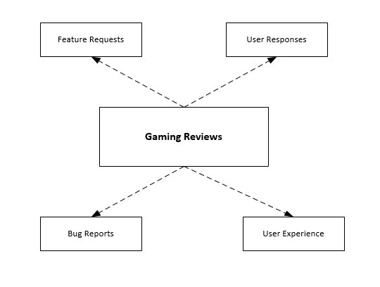
Gaming Reviews

Slide 6

Example review of EAG(Early Access games on STEAM)

Slide 7
Introduction
The steadily increasing popularity of computer games has led to the rise of a multi-billion-dollar industry.
Prior studies show that gamers are extremely hard to please, making the quality of games an important issue.
Reviews can make or break a game [5], as other potential buyers often base their purchasing decisions on the reviews of a game.
Bugs that persist into releases of video games can have negative impacts on both developers and users.
Studying gamer reviews help developers better understand the concerns and further improve the user perceived quality.

Slide 8
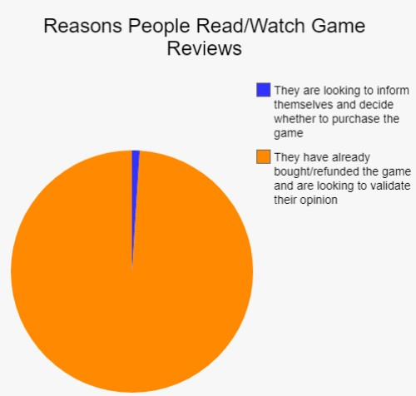
Introduction

Slide 9
Research Methodology
Defining objectives of
the solution
Literature Review for research gap
analysis and
construction of an
initial list of
evaluation factors
Design and
development of the model for multi-label
classification of
reviews
Evaluation of the
proposed approach
to determine its
applicability in the
context of real world mobile applications

Slide 10
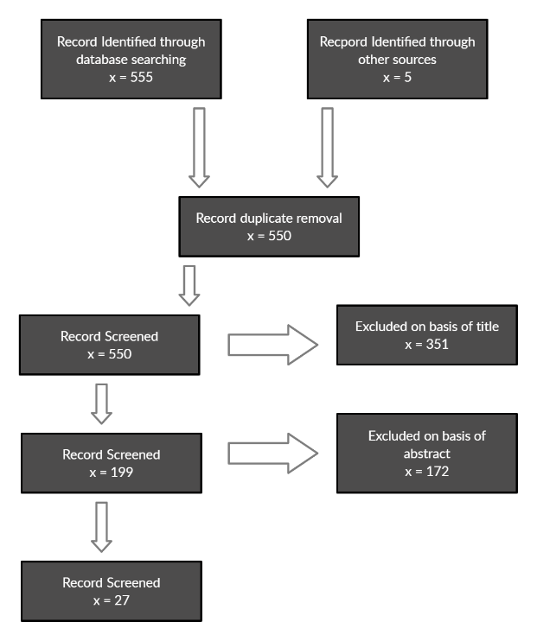
Study Selection Procedure

Slide 11
Research Question
RQ1: What is the traditional bug classification and identification process?
RQ4: What kind of techniques has been proposed in past for classification and identification of bugs from gaming reviews?
RQ2: What evaluation/classification/identification metrics have been used?
RQ3: What are gamers talking about in gaming reviews?
RQ5: What is the overall research productivity in this domain?

Slide 12
Literature Review
Ref. No., Year | Methodology/Approach | Strengths | Weaknesses | Dataset used
[1] | Data mining based techniques (Mine the review based on phrases). | User opinions in reviews Phrases from reviews | Approach cannot extract opinions corresponding to textual expressions No classification and categorization of bugs | 120 mobile apps, 2944,335 crawled reviews
[2] | Statistical Method (Pearson’s chi-squared test) | Simplifying bug reports Classification of bugs into four categories | Focused on simplifying bug reports Fewer bug reports mentioned | NetBeans and Apache Software Foundation project
[5] | Deep Learning algorithms (Deep enforcement learning DRL’s) | Navigation of FPS type games, Game exploits and bugs, distribution of visited states, and difficulty evaluation | Limited to FPS games Not all problems can be solved by RL(Reinforcement learning) technique including bugs classification and categorization | N/A
[3] | Deep Learning algorithms (sentiment analysis techniques) | Classification of app reviews into four types Bug reports, feature requests, user experiences, and text ratings | Limited to bug reports, feature only no method for bug classification | 1186 apps and 1,303,182 reviews
[4] | Static method unity linter tool | Unity games and projects | Static analysis is not particularly used to finding bugs in games No classification of bugs | 100 open source unity projects

Slide 13
Literature Review
[6] | Statistical Method (Wilcoxon signed rank test) | Similarity check between game reviews characteristics with mobile app reviews characteristics | Only collected one month of reviews that have an accurate number of playing hours | 6224 applications
[7] | Unity test tool | Testing of mobile game using unity tool | Only tested for application which is developed on unity engine No any report and identification of bugs | XYZ game
[12] | Game loop video | XML written template which generates a message based on game’s current state | GUI need to be reprogrammed for every game Detection of bugs in real time but no explanation for its classification | Five real world games
[8] | Supervised Machine Learning algorithms (Model based testing) | Model based testing to model the conceptual and behavioral details to be tested | Focused only on functional testing of the game Developers have to develop separate test ready models | 2D and 3D games
[13] | Statistical Method (Descriptive statistical method) | User reviews to understand user requirements from store Aggregation and use of feedback | No identification of bugs from user reviews | App Store application reviews (1126453)

Slide 14
Literature Review
[9] | Supervised Machine Learning algorithms (random forest classifier) | Game play videos from steam platform and YouTube, used videos meta data and compare it with keywords to identify bug videos | Limited to videos data Not able to detect bugs from textual data | 1400 Game Play Videos Labeled dataset of 96 videos
[14] | Stratify app model | Grouping of reviews based on user concerns User general sentiment on each entity User review classification | No classification of bugs | 6 Apps (Virtual table tennis, bubble shooter, Quota, Tumblr, YouTube, Speaker Boost) Game(285,091),Social(21,773,29),Media(11,646,981)
[10] | Divide-and-conquer | Possible failures in games and division in temporal and non-temporal failures, categorization of bugs | No tool to automate the process Taxonomy to just classify the bugs into different categories | YouTube videos as dataset
[11] | Statistical Method Tool (cosine similarity measure) | Bug fixes taken from app updates, Frequency of bugs in games | Manually evaluated these fixes to find the true recurring bugs | 30 Games, 12,122 bugs

Slide 15
Problem Statement
Several research studies have been conducted to mine and categorize user-reviews into actionable software maintenance requests, including feature requests and bug reports. Existing literature has focused on user response toward games, detection of bugs in reviews.
But there is need of an automated tool which can mine the reviews and extract bugs from it and then classify them in to bugs categories and then generate bug reports from it.
Existing studies have either focused on mere identification of bug categories, or coverage of limited set of bug classes/categories. Comprehensive coverage of diverse set of bug categories such as lag, freezing, save glitch etc, is non-existent in the extant literature.

Slide 16
Proposed Research Methodology
We are using steam game platform as a case study to collect reviews of games using a custom crawler.
Pre-processing is required for a textual data to make it clean and ready for analysis
Extra symbols and article words cause extra computation complexity, while do not have any positive impact on the model performance.
Strategies including stop words removal, lemmatization and tokenization will be used to process raw text of user reviews.
Then CNN based multi-label review classifier will be implemented for classification of reviews into defined set of labels.
There are three settings for a CNN classifier for text data classification, the one is static, the second is random, and the third is non-static.

Slide 17
Proposed Research Methodology
For static and non-static, word2vec words embedding are used as pre-trained embedding of vectors.
In random CNN settings the model is trained over the randomly initialized word vectors and updated during training.

Slide 18
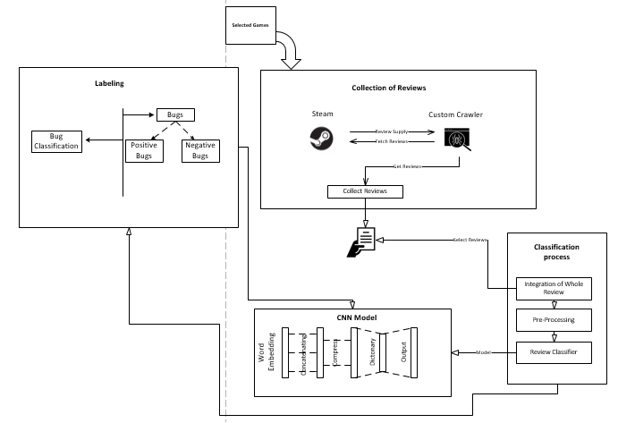
Architecture Of The Proposed Approach

Slide 19
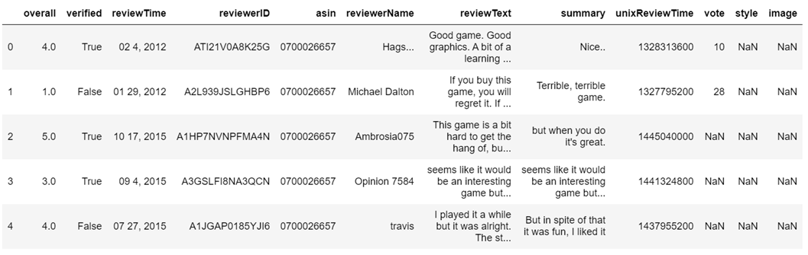
Game Reviews Dataset
Below is the image of game reviews dataset

Slide 20
Classification Process
Classification process is comprises of three fundamental steps :
Pre-Processing
Classification Model
Validation

Slide 21
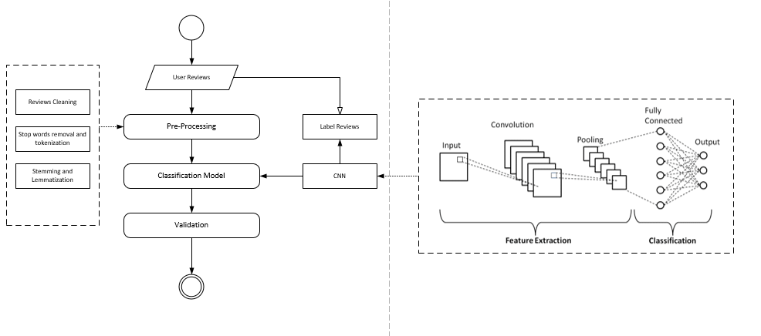
Generic process view of reviews classification approach

Slide 22
CNN (Convolution Neural Network)
The convolution layer uses filters that perform convolution operations as it is scanning the input I with respect to its dimensions. It’s hyper parameters include filter size F and padding P.
We will be using Rectified linear unit (ReLU) for activation function. It aims at introducing non-linearity's to the network (g(z) = max(0,z)).

Slide 23
CNN (Convolution Neural Network)
Filter hyper parameters:
The convolution layer contains filters, in which we will apply the following parameters.
Dimensions of a filter: We will be applying filter of size 3 * 3 to an input, which will produce the feature map.
Padding: We will be applying full padding , in which filter see the input end to end. It can be achieved by adding 0 to each side of the boundaries of the input.

Slide 24
CNN (Convolution Neural Network)
The pooling layer is a down sampling operation, typically applied after a convolution layer, which does some spatial invariance.
Type | Purpose | Representation
Max Pooling | Each pooling operation selects the maximum value of the current view.

Slide 25
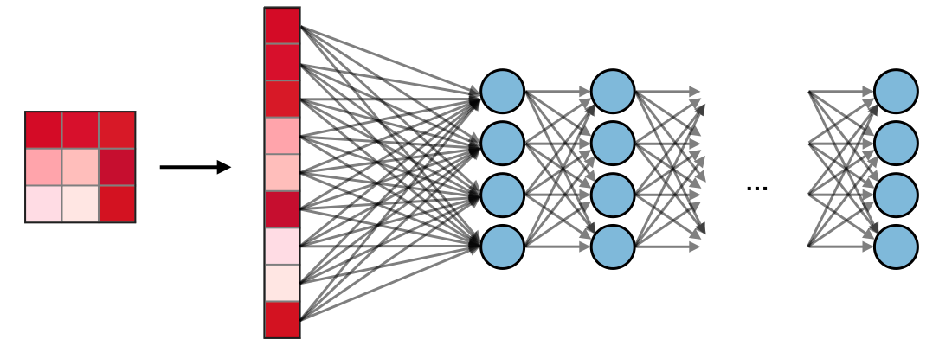
CNN (Convolution Neural Network)
The fully connected layer operates on a flattened input where each input is connected to all neurons.
Loss Function: We will be using binary classification loss function to calculate the prediction error so we can update weights accordingly.

Slide 26
Research Contribution
Model (an automated deep CNN based deep learning model has been proposed to categorize the gaming bugs).
Empirical evaluation(an empirical evaluation have been conducted to categorize the gaming bugs of STEAM engine platform games reviews).
Tool

Slide 27
References
[1] P. M. Vu, H. V Pham, T. T. Nguyen, and T. T. Nguyen, “Phrase-based extraction of user opinions in mobile app reviews,” in 2016 31st IEEE/ACM International Conference on Automated Software Engineering (ASE), 2016, pp. 726–731.
[2] M. Nayrolles and A. Hamou-Lhadj, “Towards a classification of bugs to facilitate software maintainability tasks,” Proc. - Int. Conf. Softw. Eng., pp. 25–32, 2018, doi: 10.1145/3194095.3194101.
[3] W. Maalej, Z. Kurtanović, H. Nabil, and C. Stanik, “On the automatic classification of app reviews,” Requir. Eng., vol. 21, no. 3, pp. 311–331, 2016, doi: 10.1007/s00766-016-0251-9.
[4] A. Borrelli, V. Nardone, G. A. Di Lucca, G. Canfora, and M. Di Penta, “Detecting Video Game-Specific Bad Smells in Unity Projects,” Proc. - 2020 IEEE/ACM 17th Int. Conf. Min. Softw. Repos. MSR 2020, pp. 198–208, 2020, doi: 10.1145/3379597.3387454.
[5] J. Bergdahl, C. Gordillo, K. Tollmar, and L. Gisslén, “Augmenting Automated Game Testing with Deep Reinforcement Learning,” in 2020 IEEE Conference on Games (CoG), 2020, pp. 600–603, doi: 10.1109/CoG47356.2020.9231552.
[6] D. Lin, C. P. Bezemer, Y. Zou, and A. E. Hassan, An empirical study of game reviews on the Steam platform, vol. 24, no. 1. Empirical Software Engineering, 2019.

Slide 28
References
[7] A. C. Barus, R. Deddy Hasiholan Tobing, D. N. Pratiwi, S. A. Damanik, and J. Pasaribu, “Mobile game testing: Case study of a puzzle game genre,” Proc. 2015 Int. Conf. Autom. Cogn. Sci. Opt. Micro Electro-Mechanical Syst. Inf. Technol. ICACOMIT 2015, pp. 145–149, 2016, doi: 10.1109/ICACOMIT.2015.7440194.
[8] S. Iftikhar, M. Z. Iqbal, M. U. Khan, and W. Mahmood, “An automated model based testing approach for platform games,” in 2015 ACM/IEEE 18th International Conference on Model Driven Engineering Languages and Systems (MODELS), 2015, pp. 426–435, doi: 10.1109/MODELS.2015.7338274.
[9] D. Lin, C. P. Bezemer, and A. E. Hassan, “Identifying gameplay videos that exhibit bugs in computer games,” Empir. Softw. Eng., vol. 24, no. 6, pp. 4006–4033, 2019, doi: 10.1007/s10664-019-09733-6.
[10] C. Lewis, J. Whitehead, and N. Wardrip-Fruin, “What went wrong: A taxonomy of video game bugs,” FDG 2010 - Proc. 5th Int. Conf. Found. Digit. Games, pp. 108–115, 2010, doi: 10.1145/1822348.1822363.
[11] A. Truelove, E. S. de Almeida, and I. Ahmed, “We’ll Fix It in Post: What Do Bug Fixes in Video Game Update Notes Tell Us?,” in 2021 IEEE/ACM 43rd International Conference on Software Engineering (ICSE), 2021, pp. 736–747, doi: 10.1109/ICSE43902.2021.00073.

Slide 29
References
[12] S. Varvaressos, K. Lavoie, A. B. Massé, S. Gaboury, and S. Hallé, “Automated Bug Finding in Video Games: A Case Study for Runtime Monitoring,” in 2014 IEEE Seventh International Conference on Software Testing, Verification and Validation, 2014, pp. 143–152, doi: 10.1109/ICST.2014.27.
[13] D. Pagano and W. Maalej, “User feedback in the appstore: An empirical study,” in 2013 21st IEEE International Requirements Engineering Conference (RE), 2013, pp. 125–134, doi: 10.1109/RE.2013.6636712.
[14] Y. Liu, Y. Li, Y. Guo, and M. Zhang, “Stratify Mobile App Reviews: E-LDA Model Based on Hot ‘Entity’ Discovery,” in 2016 12th International Conference on Signal-Image Technology & Internet-Based Systems (SITIS), 2016, pp. 581–588, doi: 10.1109/SITIS.2016.97.

